Slide 1
Using Tinkercad to Design Tessellations for 3D Printing
By Nora Strasser
Friends University
strasser@friends.edu

Slide 2
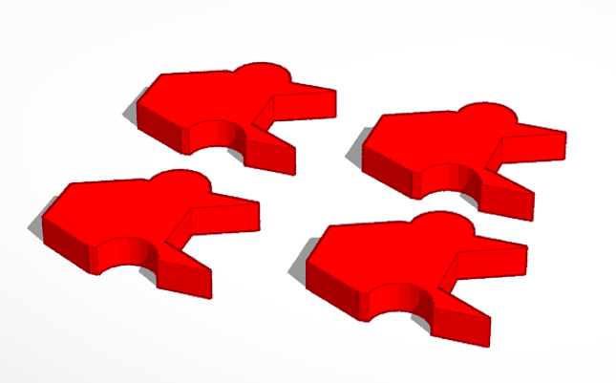
Tinkercad
www.tinkerdcad.com
Create account
Start tinkering!

Slide 3
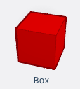
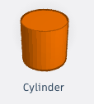
Designing a Tessellation
Click “Create New Design”.
Put the ruler on the Work Plane.
Drag a Red Box onto the Work Plane.
Adjust the Red Box to 50mm x 50mm with a height of 6mm.
Drag a Cylinder onto the Work Plane.
Adjust the Cylinder to a diameter of 50 mm and a height of 6mm.

Slide 4
Designing a Tessellation
Duplicate the Cylinder.
Drag one Cylinder so that the vertical diameter line coincides with the right side of the box.
Drag the other Cylinder so that the vertical diameter line coincides with the left side of the box.
Change the left Cylinder to a hole.

Slide 5
Designing a Tessellation
Select all the objects and group them.
Whatever you do to one side of the box, you have to duplicate for the other side and make it a hole.
Change the name of your object.
Once you have completed your object, you can create an stl file to print.

Slide 6
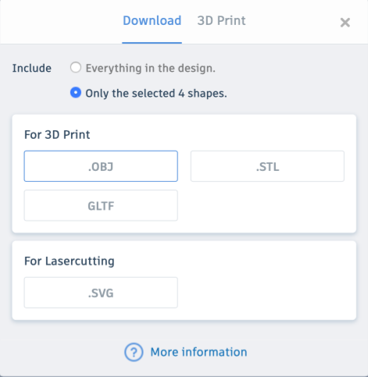
Designing a Tessellation
Click on Export.
A popup box will appear.
Choose .STL for most printers.
You can also choose only part of your design or the entire design.

Slide 7
Helpful Pointers
Use the ruler to help align objects.
Group objects and use the align tool to help position objects.
Be very precise in your measurements.
Be careful not to sink your objects into the Work Plane.
Print multiples of your objects in different colors.

